Slide 1

Special interfaces
Jan Martinovič
Fakulta elektrotechniky a informatiky
www.fei.vsb.cz
2010

Slide 2
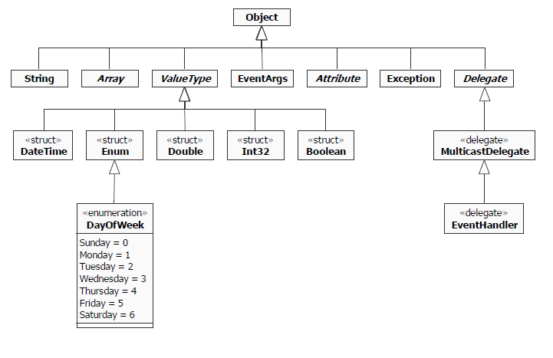
Overview

Slide 3
System.Object
Public Constructors
  Object Constructor
    Initializes a new instance of the Object class.
Public Methods
  Equals
    Overloaded. Determines whether two Object instances are equal.
  GetHashCode
    Serves as a hash function for a particular type, suitable for use in hashing algorithms and data structures like a hash table.
  GetType
    Gets the Type of the current instance.
  ReferenceEquals
    Determines whether the specified Object instances are the same instance.
  ToString
    Returns a String that represents the current Object.
Protected Methods
  Finalize
    Overridden. Allows an Object to attempt to free resources and perform other cleanup operations before the Object is reclaimed by garbage collection. In C# and C++, finalizers are expressed using destructor syntax.
  MemberwiseClone
    Creates a shallow copy of the current Object.

Slide 4
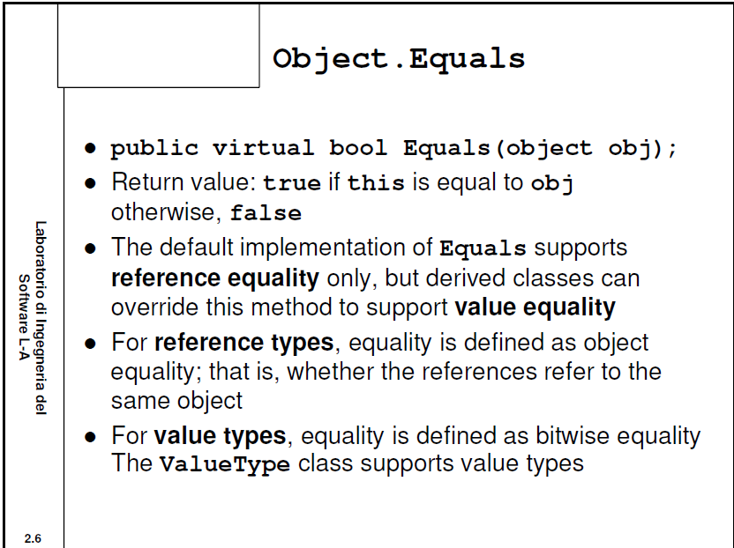

Slide 5
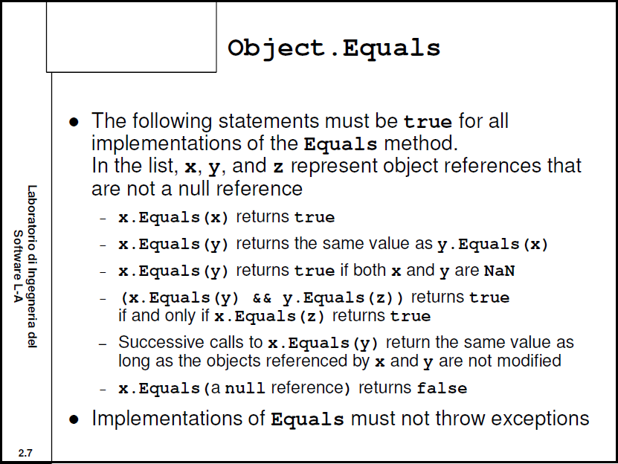

Slide 6
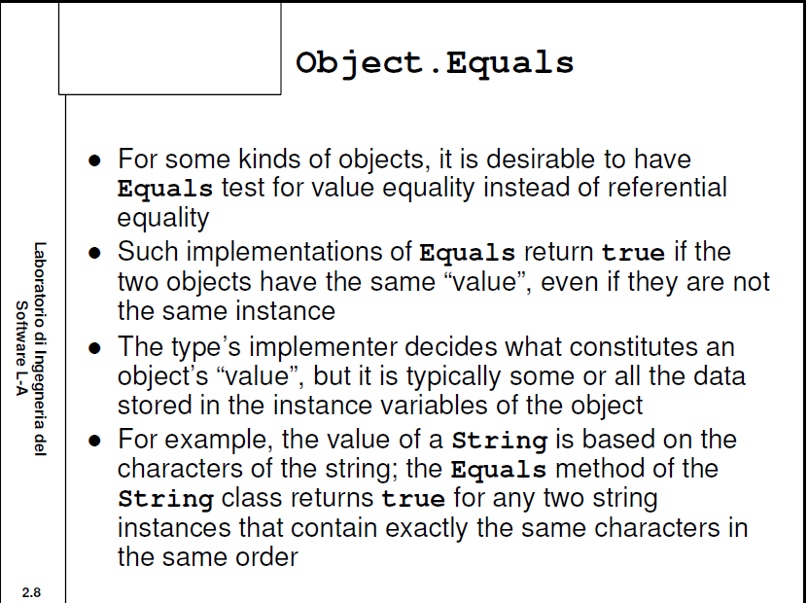

Slide 7
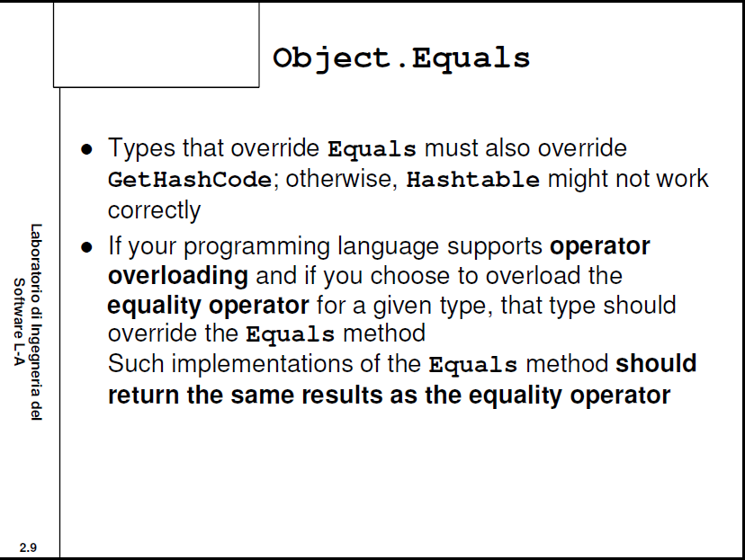

Slide 8
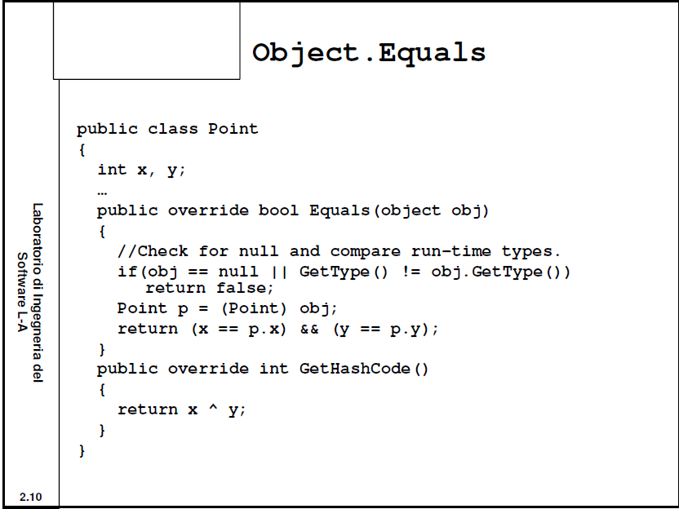

Slide 9
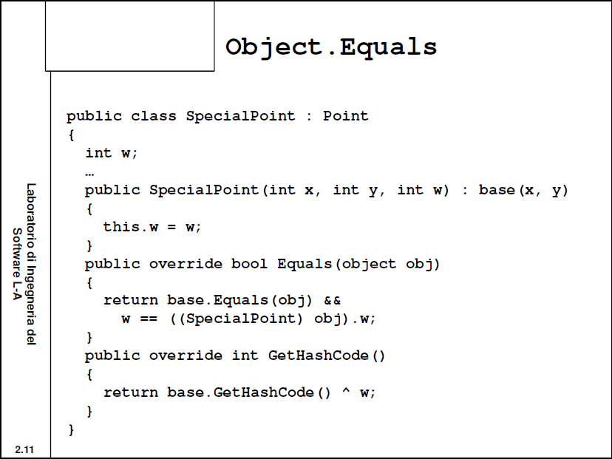

Slide 10
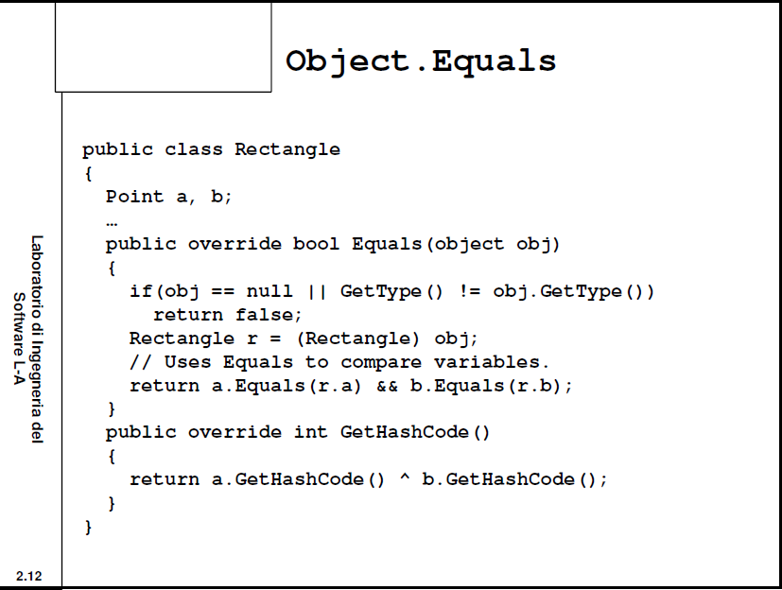

Slide 11
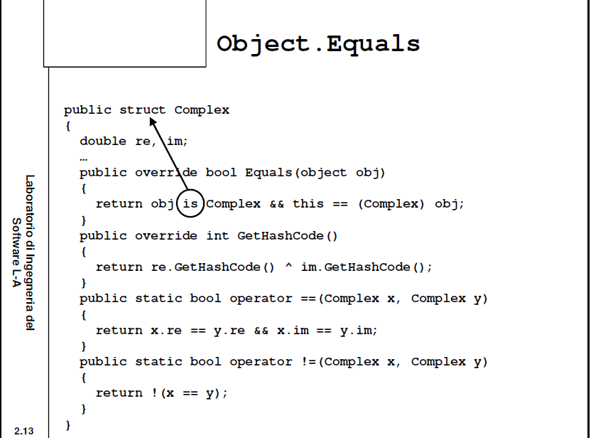

Slide 12
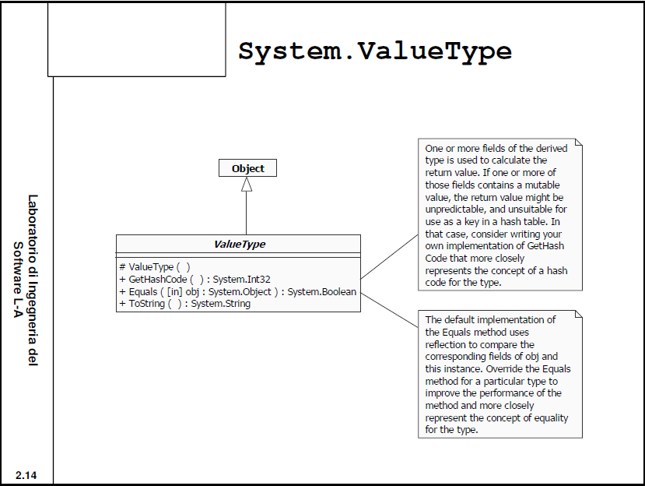

Slide 13
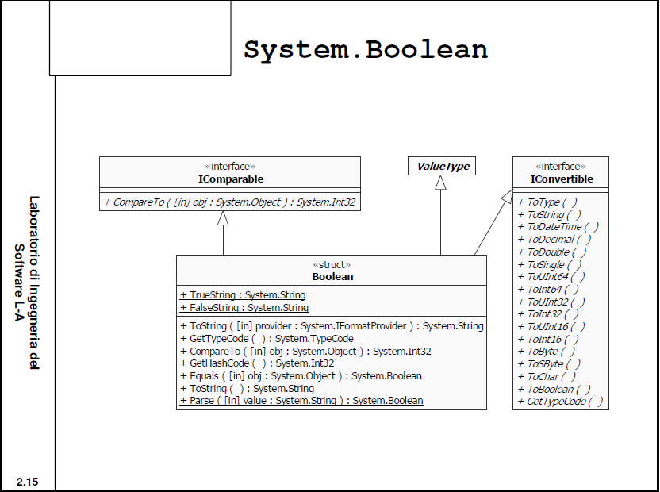

Slide 14
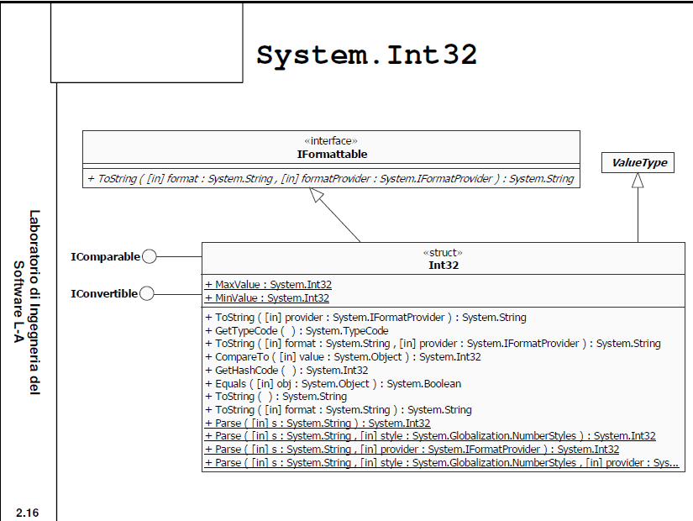

Slide 15
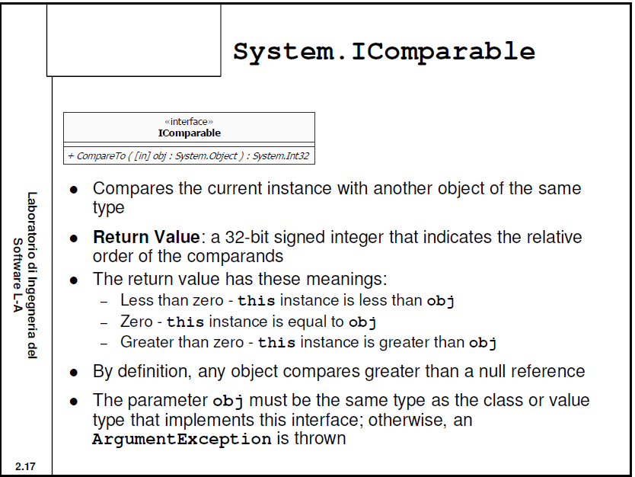

Slide 16
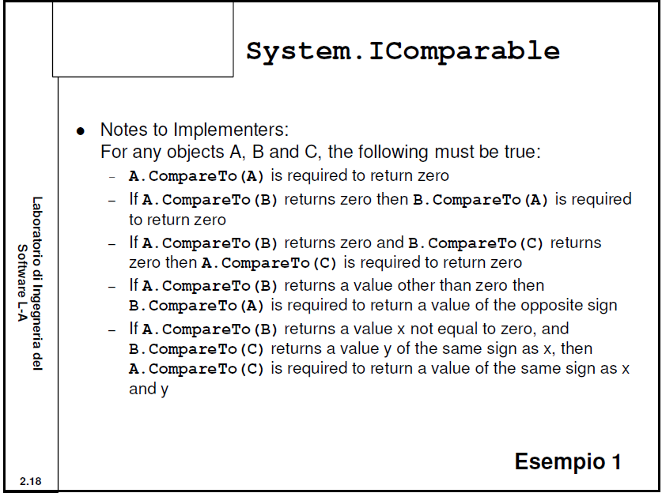

Slide 17
Demo - IComparable
http://msdn.microsoft.com/en-us/library/system.icomparable%28v=VS.80%29.aspx

Slide 18
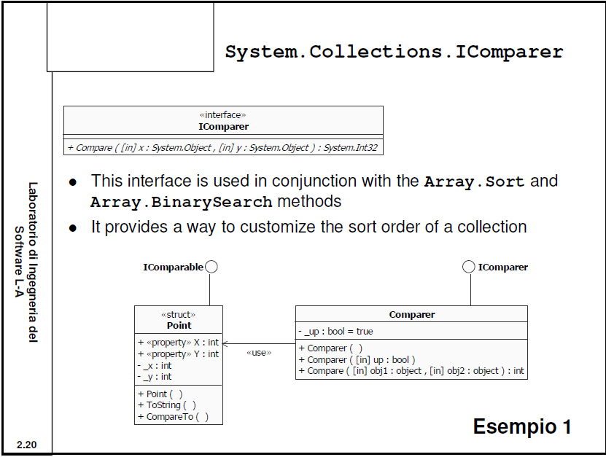

Slide 19
Demo - IComparer
http://msdn.microsoft.com/en-us/library/system.collections.icomparer.aspx

Slide 20
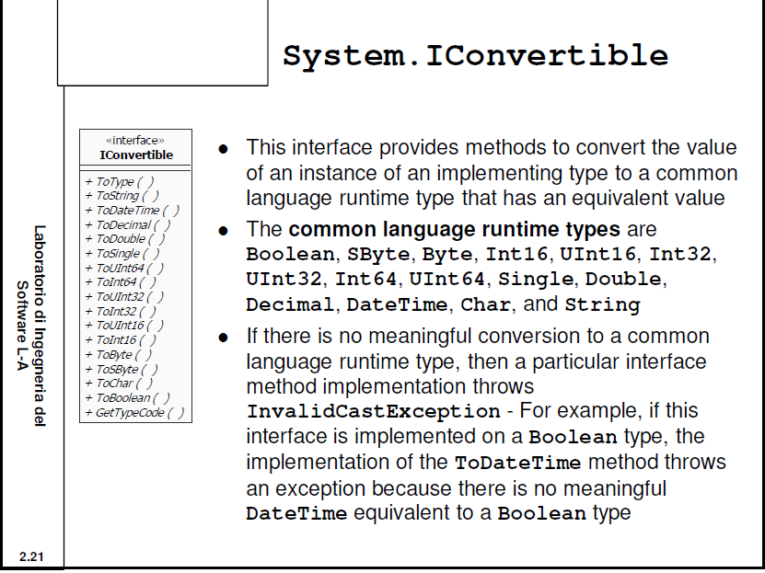

Slide 21
Demo - IConvertible
http://msdn.microsoft.com/en-us/library/system.iconvertible%28v=VS.80%29.aspx

Slide 22
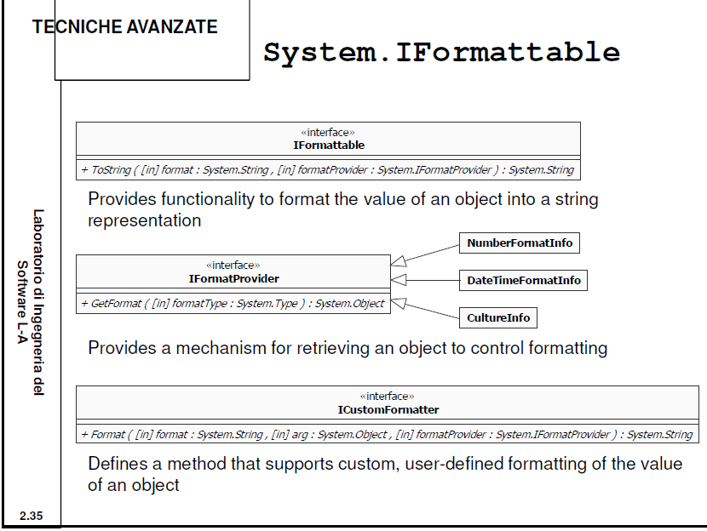

Slide 23
Demo - IFormattable
http://msdn.microsoft.com/en-us/library/system.iformattable.aspx

Slide 24
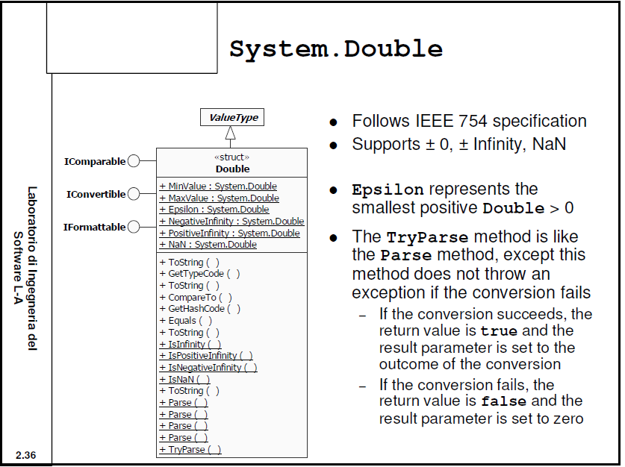

Slide 25
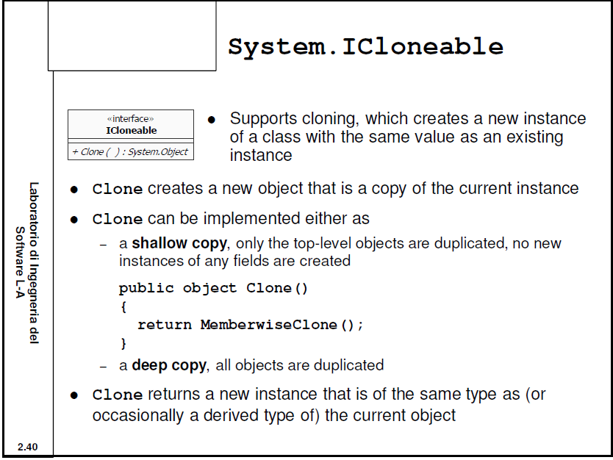

Slide 26
IEquatable
http://en.csharp-online.net/IEquatable
The System.IEquatable interface defines a type-safe method for creating a type-specific method to determine equality of instances.
Declaration syntax
  public interface IEquatable<T>
Method syntax
  The Equals method indicates whether the current object is equal to another object of the same type.
    bool Equals ( T other ) where other is an object of the same type to be compared with this object.
  Returns true if the current object is equal to the parameter object; otherwise, false.
The IEquatable.Equals method is very similar to Object.Equals. However, IEquatable.Equals is type-safe and generic—requiring no boxing and unboxing.

Slide 27
INullableValue
http://en.csharp-online.net/INullableValue
The System.INullableValue interface defines the fundamental value and existence properties for nullable types. However, it has been removed from .NET 2.0; because, nullables are now an intrinsic type in the CLR.
The INullableValue interface defines the following methods:
  The HasValue method indicates whether a nullable type has a defined value.
    bool HasValue { get; }
  The Value method gets the value of the nullable type.
    Object Value { get; }

Slide 28
IDisposable
The System.IDisposable interface defines a method of releasing unmanaged resources which have been allocated.
The Dispose method performs tasks defined by the application associated with releasing or resetting unmanaged resources. Resources like database connections, handles, files, and streams which are held by an instance of the class implementing this interface.
You should only use these classes inside a try-catch-finally statement or a using statement.

Slide 29
References
http://lia.deis.unibo.it/Courses/LabIngSw0708/Slide_2x2.pdf

